Slide 1



Data Analysis
Notes:
Hello everyone and welcome to today’s presentation on the results of the Data Analytics task. My name is Victoria J. Abdulkadir.

Slide 2


Today’s Agenda
Project recap
Problem
The Analytics team
Process
Insights
Summary
Notes:
In today's agenda, the following will be covered:
1. A recap of the project to understand the business problem we are facing, and the specific exigencies.
2. An overview of the unique problem of social buzz and how we in the Data Analytics team, have examined the issue to discover the reasons behind those difficulties.
3. An introduction of the analytics team that worked on this task.
4. The various processes used to carry out this task.
5. The insights derived after these series of procedures.

Slide 3

Social Buzz, a blooming social media and technology company has consulted with Accenture on the following business areas:
An audit of their big data practice.
Recommendations for a successful IPO.
An analysis of their data to highlight the top 5 most popular content categories.
Project Recap
Notes:
To begin, I would like to give a recap of the project.
We, at Accenture started a 3-month consultation with Social Buzz with the aim of focusing on 3 main tasks (list the tasks) which are all a superset to your present business challenges.
Social Buzz has bloomed tremendously over the years and has gained popularity and recognition amongst its users globally. Our job here at Accenture is to steer you through this process to ensure you get it right once and for all.

Slide 4


Problem
Over the past 5 years, Social Buzz has reached more than 500 million active users each month.
Posted over 100,000 pieces of content in a day.
This translates to over 36,500,000 posted contents per year.
This is huge!
To make the best of these enormous numbers, they need to discover ways to boost their scaling process effectively.
Notes:
You gave us a background on how much data you've been creating:
You told us that your platform receives over 100000 posts per day which amounts to 36 500 000 posts every year, of which, this is a whole lot. And you know what? These are all unstructured data making that is very hard to make sense of.
Clearly, this a very challenging problem.
With this knowledge, we need to start focusing on what contents are popular, take advantage of their popularity and give the audience an unforgettable, pleasant experience that is worth their time.
This is achievable.
That is why our team have taken up the challenge to help you discover the potentials that all your contents have.

Slide 5



ANDREW FLEMING
Chief Technical Architect
The Analytics team
MARCUS ROMPTON
Senior Data Expert
VICTORIA J. ABDULKADIR
Data Analyst
Notes:
Speaking of teams, I would like to introduce our data analytics team to you.
Here at Accenture, we have different teams handling various aspects of this project, but we have 3 people in my team who worked on this task.
We have, Andrew Fleming, the Chief Technical Architect who helped to create and maintain high quality data for this analysis.
Also, Marcus Rompton, a senior data expert who with his years of experience and great skills developed the systems and processes forthis analysis. He also provided engineering services for this project.
And finally, myself, Victoria J. Abdulkadir, who was sole responsibility was to collect, review, and analyze the data in this project to identify key insights.

Slide 6
Process
1
Data Understanding
2
Data Cleaning
3
Data Modeling
4
Data Analysis
5
Data Insights
Notes:
We tackled the problem in 5 steps:
1. Data understanding – This was a crucial step in this process because we needed to make sense of the raw data and identify those needed for this task.
2. Data cleaning - after understanding your business data, we corrected errors found in them by formatting and performing other functions to keep only the relevant data needed for the analysis.
3. After cleaning the raw data, we needed to model this data into a dataset by connecting the data points and structures that can precisely answer the business questions.
4. Data Analysis – We explored the cleaned and modeled data to answer the original business problem. We generated visualizations from the cleaned dataset, which helped explain the analysis..
5. The analysis led to our uncovering insights which we used to make recommendations for your business.

Slide 7

Insights
NUMBER OF CONTENT CATEGORIES
POST WITH THE HIGHEST NUMBER OF REACTIONS IS “ANIMAL”
MAY 2021 HAD THE HIGHEST NUMER OF POSTS
16
1897
2138
Notes:
From the insights we discovered from your data, we found that you had a total of 16 unique categories of posts across your sample dataset.
Also, there was 1897 posts from just the “animals” category alone! You must have so many animal lovers on your platform.
And also the most common month for users to post within was in may 2021, the audience were actively posting or reacting to contents about animals during this period
But we wanted to find out the top 5 most popular categories of posts

Slide 8
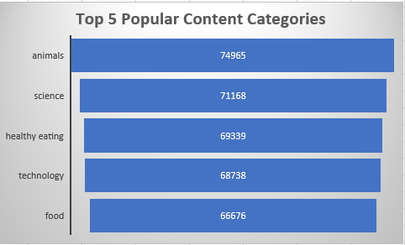
Notes:
From the chart drawn from our analysis, you can see that the top 5 most popular categories of posts were animals, science, healthy eating, technology, and food in descending order.
Posts on animals had an aggregate popularity score of over 74000. This means that the platform has a lot of animal lovers or pet owners. Healthy eating and food being among the top 5 shows that people really care about what they eat and how it affects their health. They want to adjust their eating habits. Science and technology being in the top 5 also shows that there is increasing awareness of the impact of science and technology in their lives and environment. They also want to know the next new thing in those areas.

Slide 9
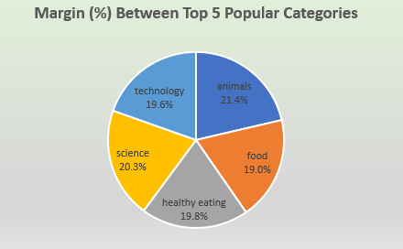
Notes:
Additionally, from this pie chart you can see that the numbers from the previous chart have been converted to percentages. We did that to understand the differences between each of the categories and discovered that they do not deviate a lot.
The difference between the 1st most popular and the 5th most popular is 2.4%. The other categories in between the 1st most popular and the 5th have differences of 0.5% and slightly less.
This shows that the science, healthy eating, and technology categories have about equal audience popularity.

Slide 10

In conclusion:
We can see that posts about animals usually have more positive reactions, this shows that most of the people easily relate with such posts.
Other categories that have the potential of experiencing a massive boost in audience engagement are “healthy eating”, “Science”, and “Technology”. You can leverage on followers’ interests by working with experts in those fields to bring originality to the contents.
Accenture is ready to work with you throughout this phase and in the future to ensure that analysis and insights to your data are given instantaneously.
Summary
Notes:
In conclusion,
We have been able to discover the top 5 most popular categories.
We have also spotted the categories that have the potential of attracting more audience engagement and suggested working with experts in those field to deliver authentic contents.
We at accenture are ready to work with your organization after this task to bring more insights and life to your data.

Slide 11

Thank you!
ANY QUESTIONS?
Notes:
Thank you for listening. At this point, you can please ask questions for further clarifications.

